Slide 1
Chapter 1 Structure and Bonding

Slide 2
Learning Objectives
(1.1)
Atomic structure: The nucleus
(1.2)
Atomic structure: Orbitals
(1.3)
Atomic structure: Electron configurations
(1.4)
Development of chemical bonding theory

Slide 3
Learning Objectives
(1.5)
Describing chemical bonds: Valence bond theory
(1.6)
sp³ hybrid orbitals and the structure of methane
(1.7)
sp³ hybrid orbitals and the structure of ethane
(1.8)
sp² hybrid orbitals and the structure of ethylene

Slide 4
Learning Objectives
(1.9)
sp hybrid orbitals and the structure of acetylene
(1.10)
Hybridization of nitrogen, oxygen, phosphorus, and sulfur
(1.11)
Describing chemical bonds: Molecular orbital theory
(1.12)
Drawing chemical structures

Slide 5
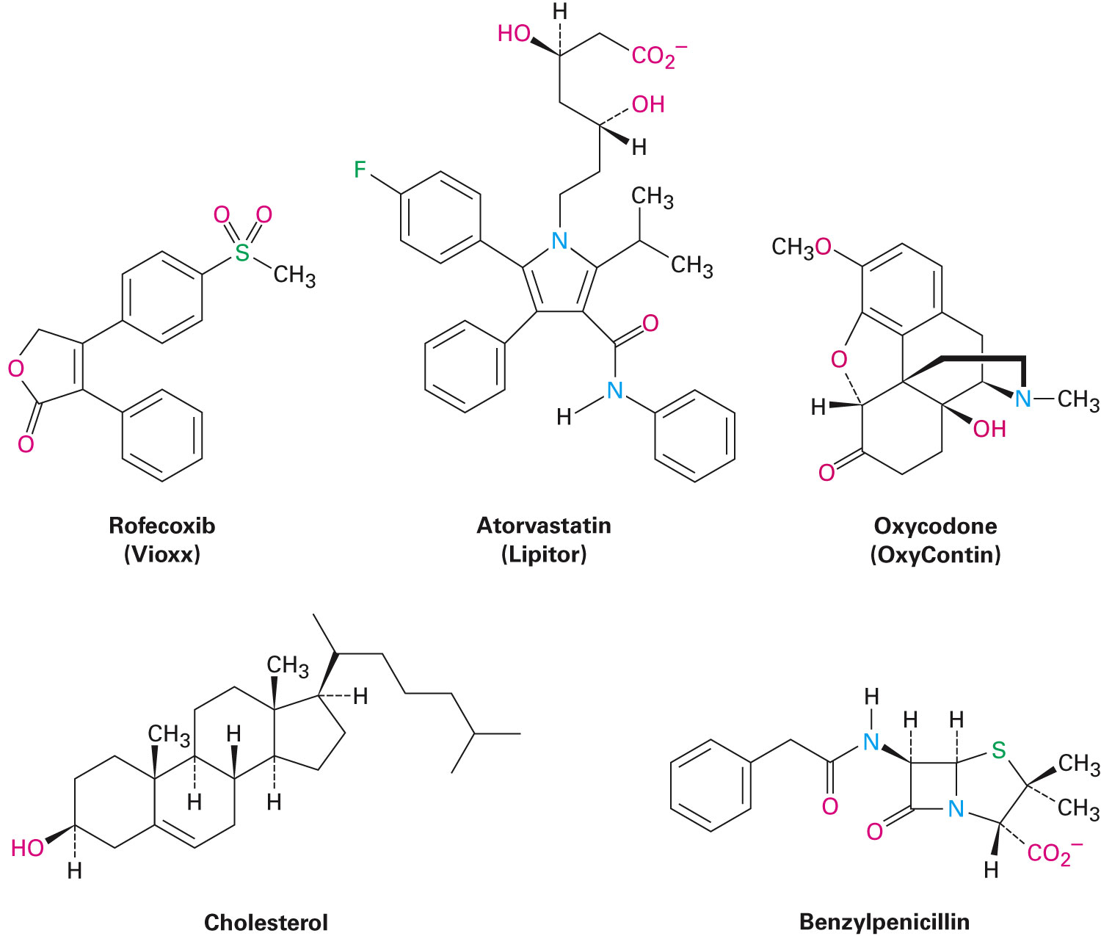
What is Organic Chemistry?
Living things are made of organic chemicals
Proteins that make up hair
DNA
Foods and medicines

Slide 6
Origins of Organic Chemistry
Foundations date from mid-1700’s
Compounds obtained from plants and animals
Low-melting solids
Hard to isolate, purify, and work with
Organic compounds were considered to have some vital force as they were from living sources
Thought that it could not be synthesized in laboratory

Slide 7
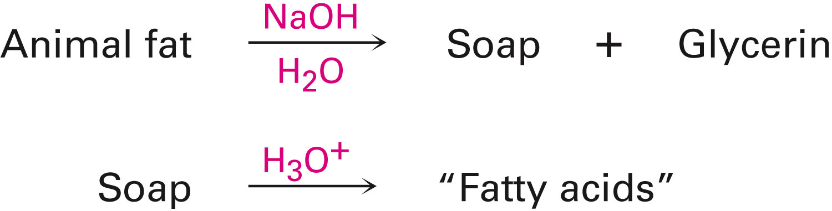
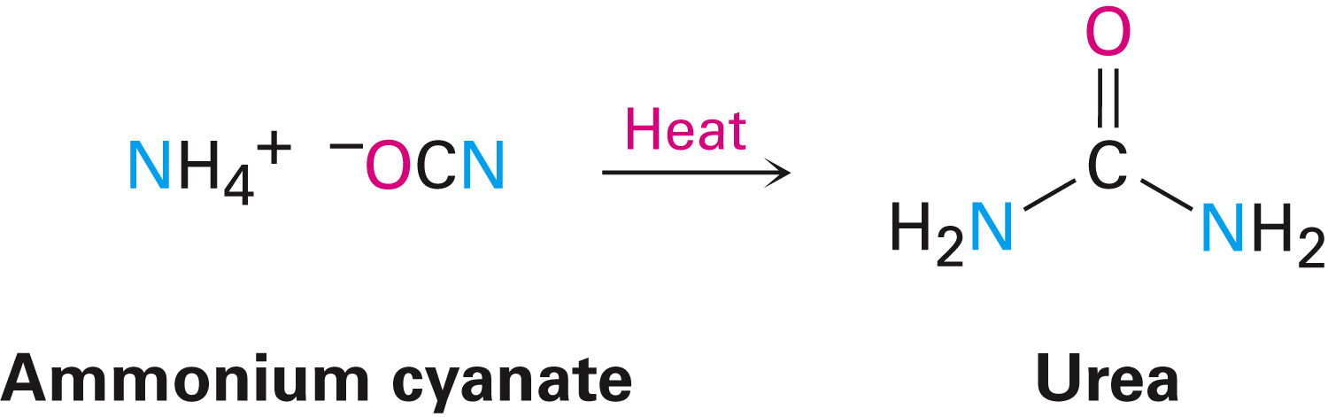
Origins of Organic Chemistry
1816, Chevreul found that soap can be separated into several organic compounds which he termed fatty acids
1828, Wöhler showed that it was possible to convert inorganic salt ammonium cyanate into organic substance urea

Slide 8
Organic Chemistry
Study of carbon compounds
More than 50 million known chemical compounds contain carbon
Carbon is a group 4A element
Can share 4 valence electrons and form 4 covalent bonds
Able to bond with one another to form long chains and rings
Only element that has the ability to form immense diversity of compounds

Slide 9
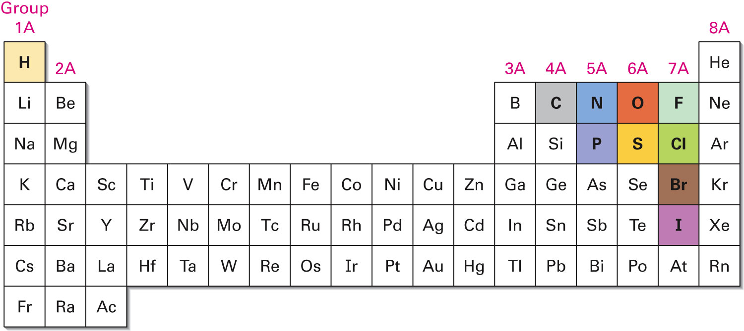
Figure 1.1 - The Position of Carbon in the Periodic Table

Slide 10
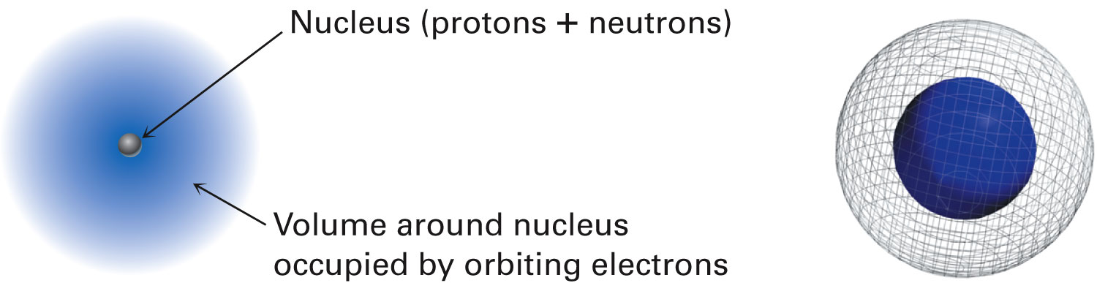
Atomic Structure - The Nucleus
Positively charged
Surrounded by a cloud of negatively charged electrons (at a distance of 10⁻¹⁰ m)
Consist of subatomic particles
Protons, positively charged
Neutrons, electrically neutral
Notes:
Atomic structure: The nucleus

Slide 11
Atomic Structure - The Nucleus
Diameter of an atom is about 2×10⁻¹⁰ m
200 picometers (pm) [the unit ångström (Å) is 10⁻¹⁰ m = 100 pm]
Notes:
Atomic structure: The nucleus

Slide 12
Atomic Number and Atomic Mass
Atomic number (Z) - Number of protons in an atom's nucleus
Mass number (A) - Number of protons plus neutrons
Atoms of a given element have the same atomic number
Isotopes: Atoms with the same atomic number but different mass numbers
Atomic mass (atomic weight) - Weighted average mass in atomic mass units (amu) of an element’s naturally occurring isotopes
Notes:
Atomic structure: The nucleus

Slide 13
Atomic Structure - Orbitals
Wave equation - Mathematical equation which describes the behavior of a specific electron in an atom
Wave function, or orbital, is the solution of wave equation
Denoted by the Greek letter psi (Ψ)
Plot of ψ² describes where an electron is most likely to be
An electron cloud has no specific boundary
Most probable area is considered
Notes:
Atomic structure: Orbitals

Slide 14
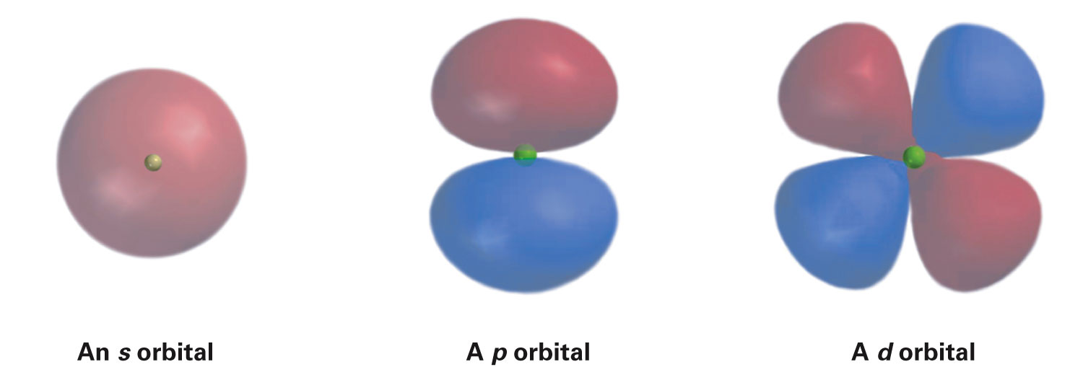
Atomic Structure - Orbitals
s, p, d, and f are different kinds of orbitals
s and p orbitals are common in organic and biological chemistry
s orbitals - Spherical, nucleus at center
p orbitals - Dumbbell-shaped, nucleus at middle
d orbitals - Elongated dumbbell-shaped, nucleus at center
Notes:
Atomic structure: Orbitals

Slide 15
Atomic Structure - Orbitals
Orbitals in an atom are organized into different electron shells
Centered around the nucleus in shells of increasing size and energy
Different shells contain different numbers and kinds of orbitals
Each orbital can be occupied by two electrons
Notes:
Atomic structure: Orbitals

Slide 16
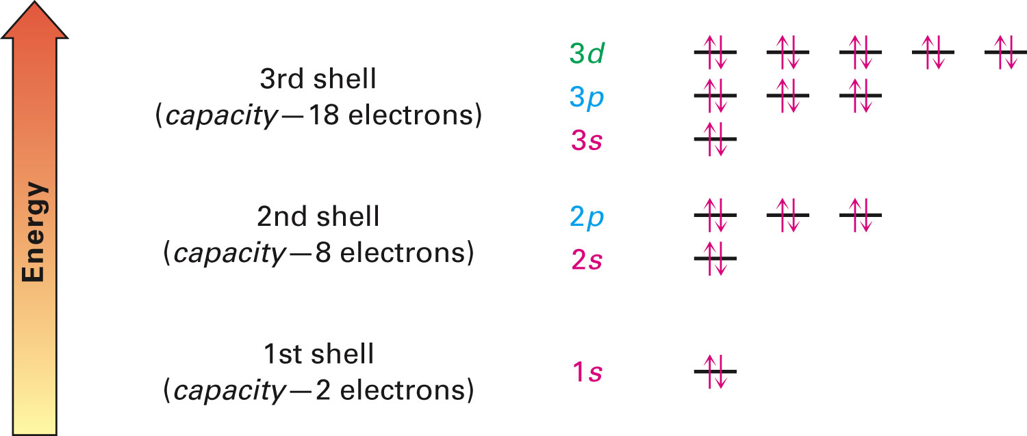
Figure 1.4 - The Energy Levels of Electrons in an Atom
Notes:
Atomic structure: Orbitals

Slide 17
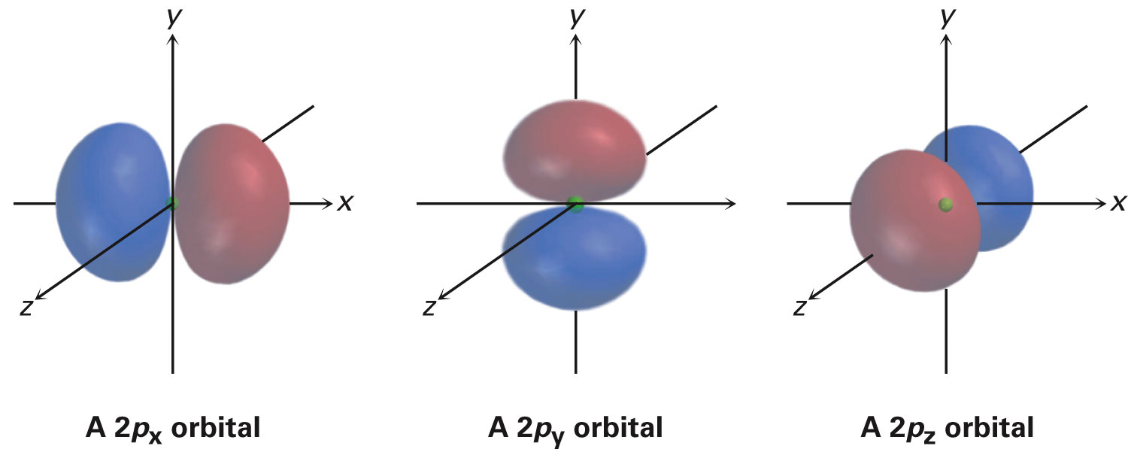
P-Orbitals
Each shell consists of three mutually perpendicular p orbitals
Denoted p_{x}, p_{y}, and p_{z}
Node: Region of zero electron density
Separates two lobes of each p orbital
Notes:
Atomic structure: Orbitals

Slide 18
Atomic Structure: Electron Configurations
Ground-state electron configuration: Listing of orbitals occupied by an atom’s electrons
Called lowest-energy arrangement
Rules
Lowest-energy orbitals fill first, in the order of 1s → 2s → 2p → 3s → 3p → 4s → 3d
Aufbau principle
Notes:
Atomic structure: Electron configurations

Slide 19
Atomic Structure: Electron Configurations
Electrons act as if they were spinning around an axis
Spin can have only two orientations, up (↑) and down (↓)
Only two electrons can occupy an orbital, and they must be of opposite spin
Pauli exclusion principle
If two or more empty orbitals of equal energy are available, electrons occupy each with parallel spins until all orbitals have one electron
Hund's rule
Notes:
Atomic structure: Electron configurations

Slide 20
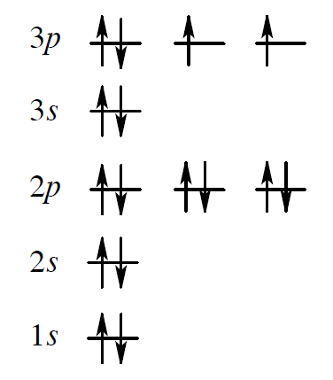
Worked Example
Give the ground-state electron configuration for sulfur
Solution:
Atomic number of sulfur is 16
Number of electrons = 16
In a more concise way it can be written as
1s² 2s² 2p⁶ 3s² 3p⁴
Notes:
Atomic structure: Electron configurations

Slide 21
Worked Example
How many electrons does magnesium have in its outermost electron shell?
Solution:
Elements of the periodic table are organized into groups based on the number of outer-shell electrons each element has
Using the periodic table we locate the group of the element, magnesium
Magnesium - Group 2A
Has two electrons in its outermost shell
Notes:
Atomic structure: Electron configurations

Slide 22
Development of Chemical Bonding Theory
Kekulé and Couper independently observed that carbon is tetravalent
Jacobus Van't Hoff and Le Bel proposed that the four bonds of carbon have specific spatial directions
Atoms surround carbon at corners of a regular tetrahedron
Notes:
Development of chemical bonding theory

Slide 23
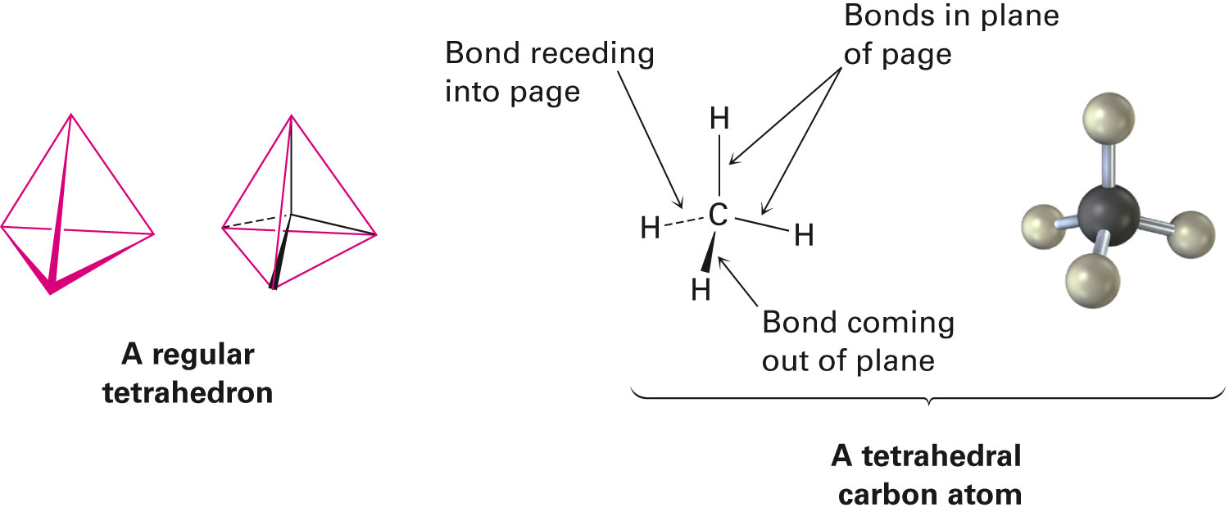
Figure 1.6 - A Representation of a Tetrahedral Carbon Atom
Notes:
Development of chemical bonding theory

Slide 24
Development of Chemical Bonding Theory
Atoms form bonds because the resulting compound is more stable than the separate atoms
Valence shell: Atom’s outermost shell
Impart special stability to the noble gas elements
Ionic bonds - Ions held together by a electrostatic attraction
Formed as a result of electron transfers
Covalent bond: Formed by sharing of electrons
Organic compounds have covalent bonds from sharing electrons
Notes:
Development of chemical bonding theory

Slide 25
Development of Chemical Bonding Theory
Molecule: Neutral collection of atoms held together by covalent bonds
Electron-dot structures: Represents valence shell electrons of an atom as dots
Called Lewis structures
Line-bond structures: Indicates two-electron covalent bond as a line drawn between atoms
Called Kekulé structures
Notes:
Development of chemical bonding theory

Slide 26
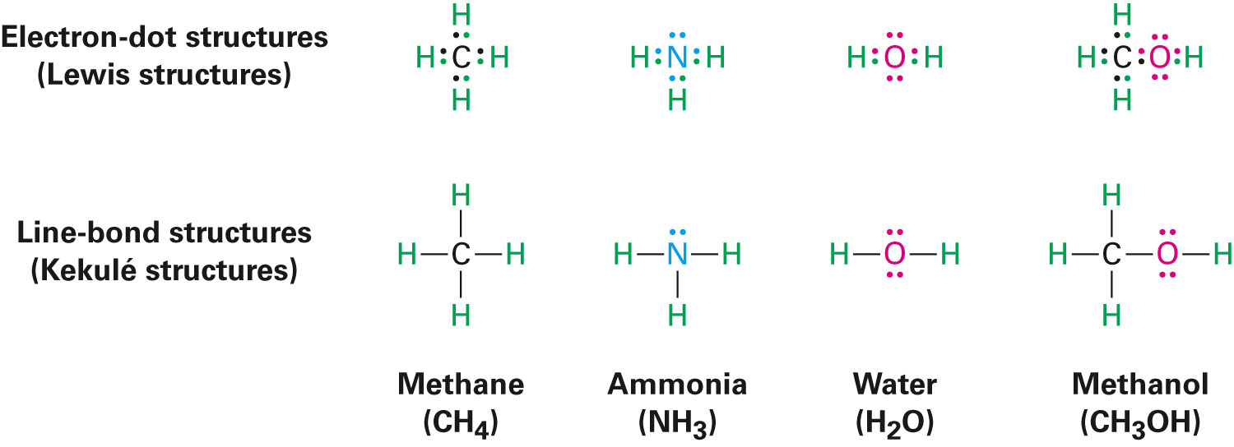
Development of Chemical Bonding Theory
Notes:
Development of chemical bonding theory

Slide 27
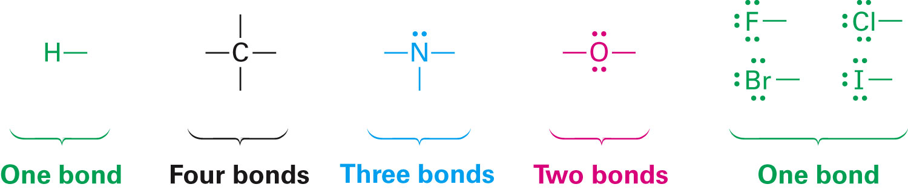
Development of Chemical Bonding Theory
Number of covalent bonds an atom forms depends on the number of additional valence electrons it needs to reach a stable octet
Carbon has four valence electrons (2s² 2p²), forming four bonds
Nitrogen has five valence electrons (2s² 2p³), forming three bonds
Notes:
Development of chemical bonding theory

Slide 28
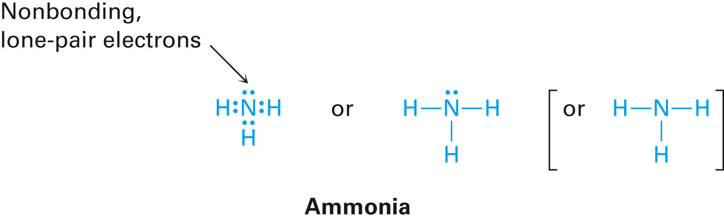
Non-Bonding Electrons
Lone pair - Valence electrons not used in bonding
Example
Nitrogen atom in ammonia (NH₃)
Shares six valence electrons in three covalent bonds
Two valence electrons are nonbonding lone pair
Notes:
Development of chemical bonding theory

Slide 29
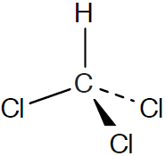
Worked Example
Draw a molecule of chloroform, CHCl₃, using solid, wedged, and dashed lines to show its tetrahedral geometry
Solution:
Notes:
Development of chemical bonding theory

Slide 30
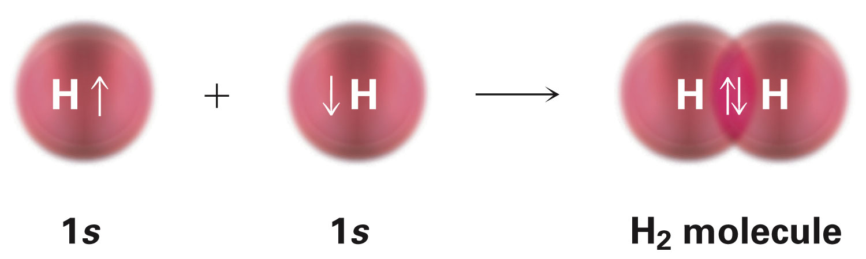
Valence Bond Theory
Covalent bond forms when two atoms approach each other closely so that a singly occupied orbital on one atom overlaps a singly occupied orbital on the other atom
H–H bond results from the overlap of two singly occupied hydrogen 1s orbitals
H–H bond is cylindrically symmetrical, sigma (σ) bond
Notes:
Describing chemical bonds: Valence bond theory

Slide 31
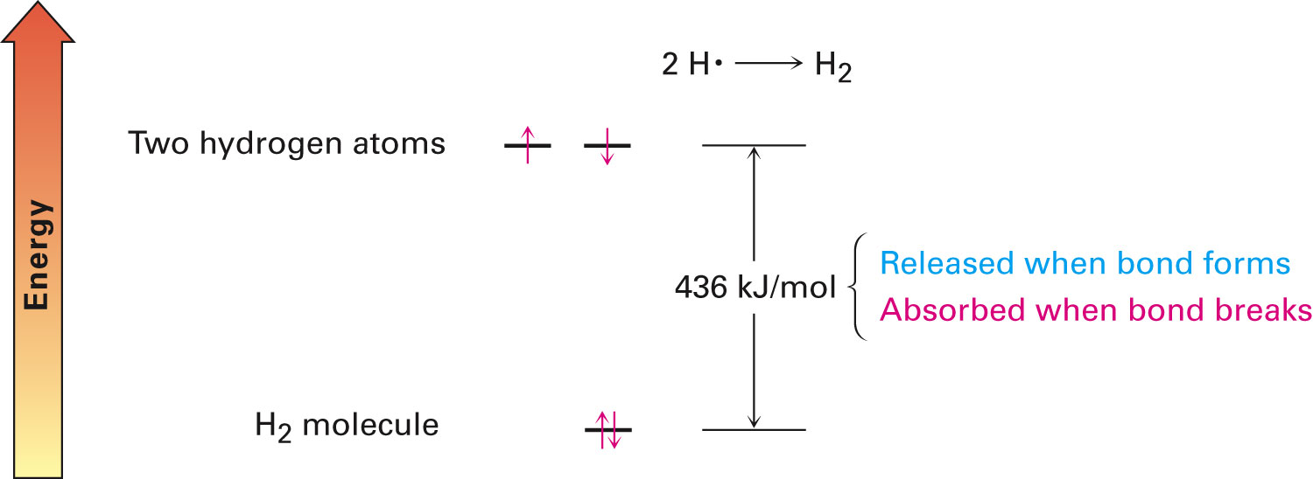
Valence Bond Theory
Reaction 2 H· → H₂ releases 436 kJ/mol
H–H has a bond strength of 436 kJ/mol (1 kJ = 0.2390 kcal; 1 kcal = 4.184 kJ)
Notes:
Describing chemical bonds: Valence bond theory

Slide 32
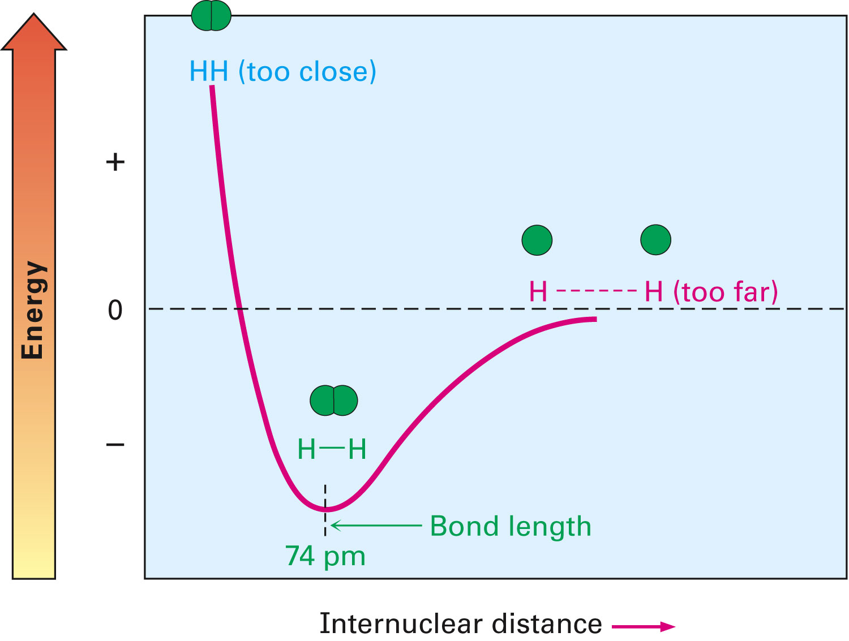
Valence Bond Theory
Bond length: Ideal distance between nuclei that leads to maximum stability
If too close, they repel
If too far apart, bonding is weak
Notes:
Describing chemical bonds: Valence bond theory

Slide 33
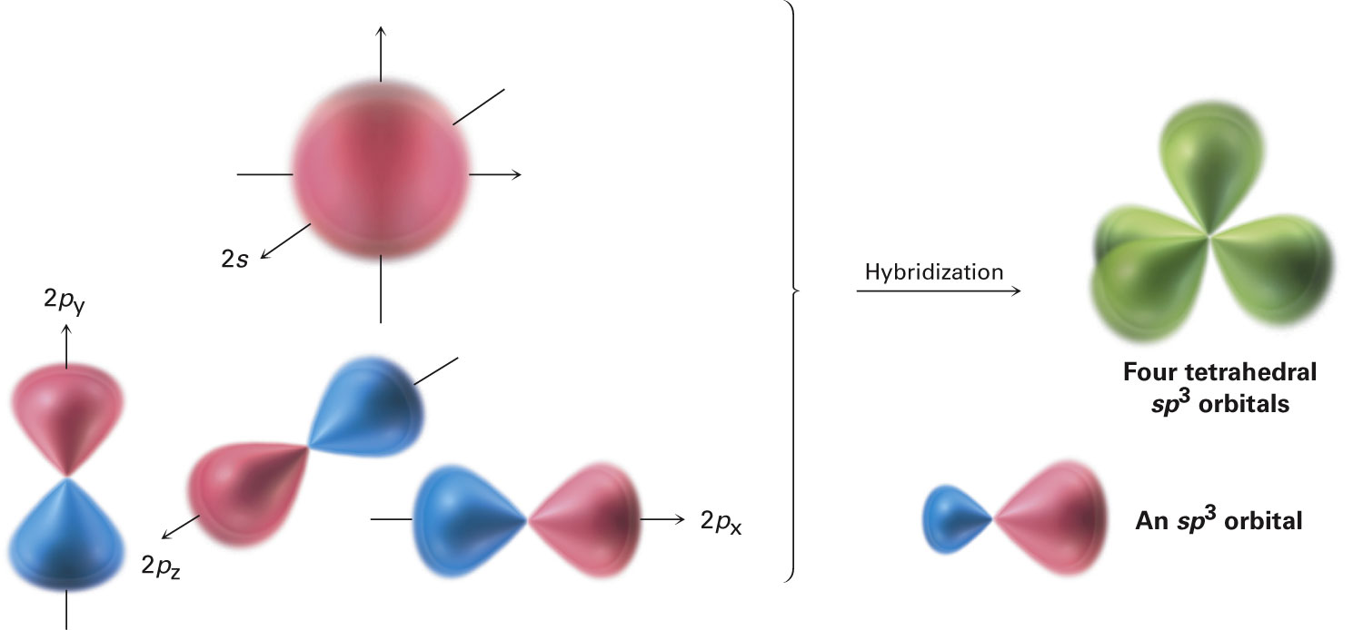
sp³ Orbitals and the Structure of Methane
Carbon has 4 valence electrons (2s² 2p²)
In CH₄, all C–H bonds are identical (tetrahedral)
sp³ hybrid orbitals: s orbital and three p orbitals combine to form four equivalent, unsymmetrical, tetrahedrally oriented orbitals
Notes:
sp³ hybrid orbitals and the structure of methane

Slide 34
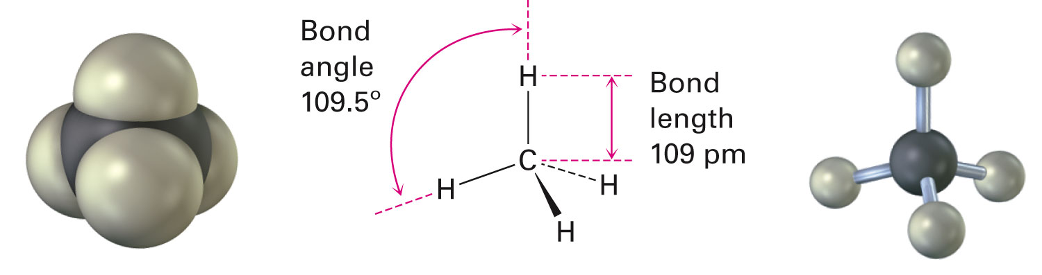
sp³ Orbitals and the Structure of Methane
sp³ orbitals in a C atom overlap with 1s orbitals of an H atom to form four identical C–H bonds
Each C–H bond has a strength of 439 kJ/mol and a length of 109 pm
Bond angle: Formed between two adjacent bonds
Notes:
sp³ hybrid orbitals and the structure of methane

Slide 35
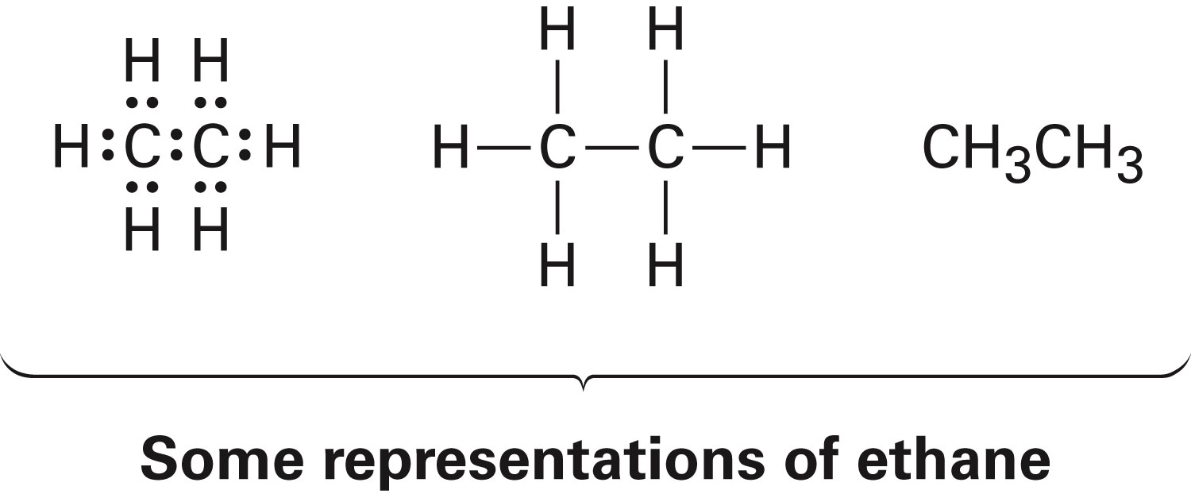
sp³ Orbitals and the Structure of Ethane
Two C’s bond to each other by σ overlap of an sp³ orbital from each
Three sp³ orbitals on each C overlap with H 1s orbitals to form six C–H bonds
C–H bond strength in ethane is 421 kJ/mol
C–C bond is 154 pm long and strength is 377 kJ/mol
Bond angles of ethane are tetrahedral
Notes:
sp³ hybrid orbitals and the structure of methane

Slide 36
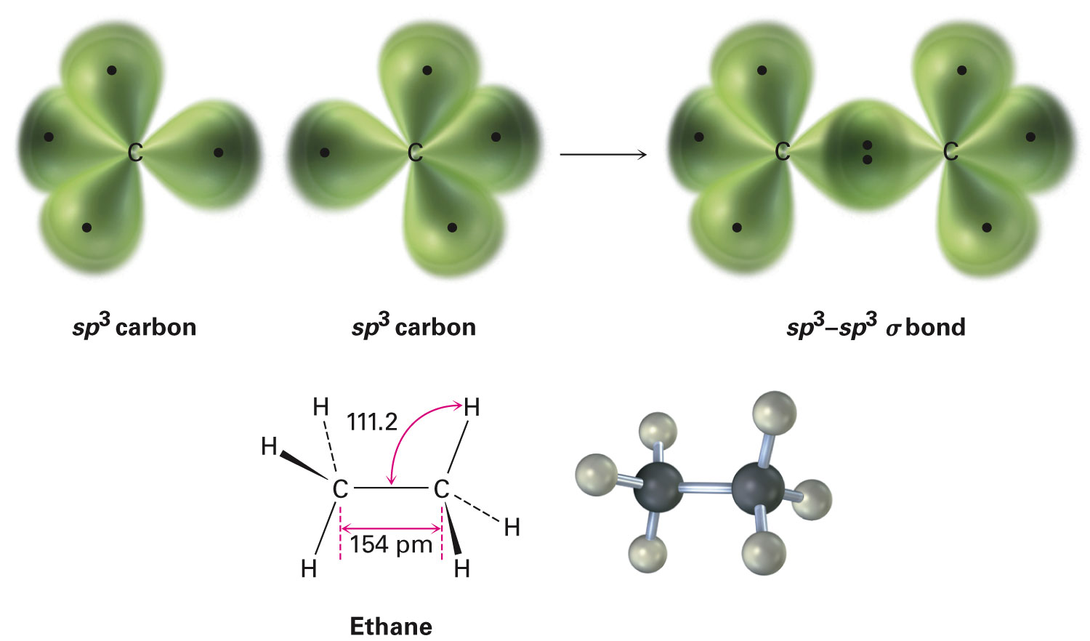
Figure 1.12 - The Structure of Ethane
Notes:
sp³ hybrid orbitals and the structure of ethane

Slide 37
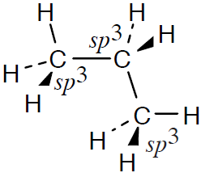
Worked Example
Draw a line-bond structure for propane, CH₃CH₂CH₃
Predict the value of each bond angle, and indicate the overall shape of the molecule
Solution:
Geometry - Tetrahedral
Bond angles - 109°(approximately)
Notes:
sp³ hybrid orbitals and the structure of ethane

Slide 38
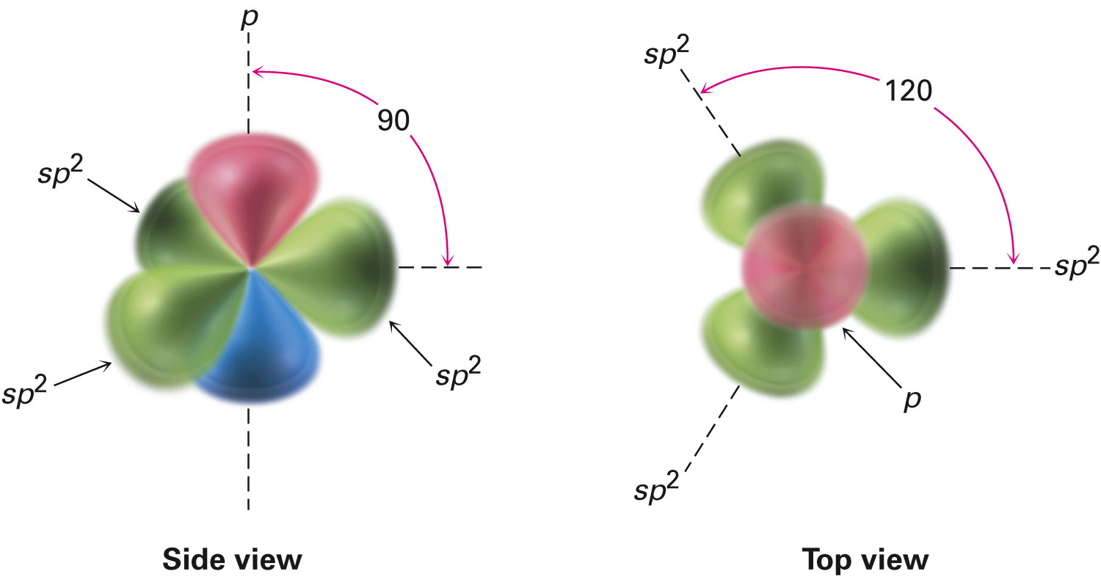
sp² Orbitals and the Structure of Ethylene
sp² hybrid orbitals: Derived by combination of an s atomic orbital with two p atomic orbitals
sp² orbitals are in a plane with an angle of 120°from each other
Remaining p orbital is perpendicular to the plane
Notes:
sp² hybrid orbitals and the structure of ethylene

Slide 39
sp² Orbitals and the Structure of Ethylene
Two sp² hybridized orbitals overlap to form a σ bond
p orbitals interact by sideways overlap to form a pi (π) bond
sp²–sp² σ bond and 2p–2p π bond result in sharing four electrons and formation of C–C double bond
Electrons in the σ bond are centered between nuclei
Electrons in the π bond occupy regions on either side of a line between nuclei
Notes:
sp² hybrid orbitals and the structure of ethylene

Slide 40
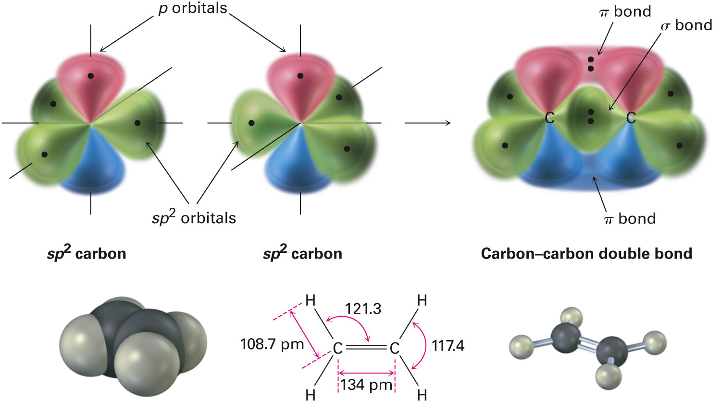
Structure of Ethylene
H atoms form s bonds with four sp² orbitals
H–C–H and H–C–C form bond angles of about 120°
C–C double bond in ethylene is shorter and stronger than single bond in ethane
Notes:
sp² hybrid orbitals and the structure of ethylene

Slide 41
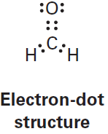
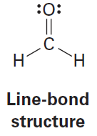
Worked Example
Draw electron-dot and line-bond structures of formaldehyde
Indicate the hybridization of the carbon orbitals
Solution:
Two hydrogens, one carbon, and one oxygen can combine in one way
The orbitals are sp²-hybridized
Notes:
sp² hybrid orbitals and the structure of ethylene

Slide 42
sp Orbitals and the Structure of Acetylene
Carbon can form a triple bond sharing six electrons
Carbon 2s orbital hybridizes with a single p orbital giving two sp hybrids
Two p orbitals remain unchanged
sp orbitals are linear, 180°apart on x-axis
Two p orbitals are perpendicular on the y-axis and the z-axis
Notes:
sp hybrid orbitals and the structure of acetylene

Slide 43
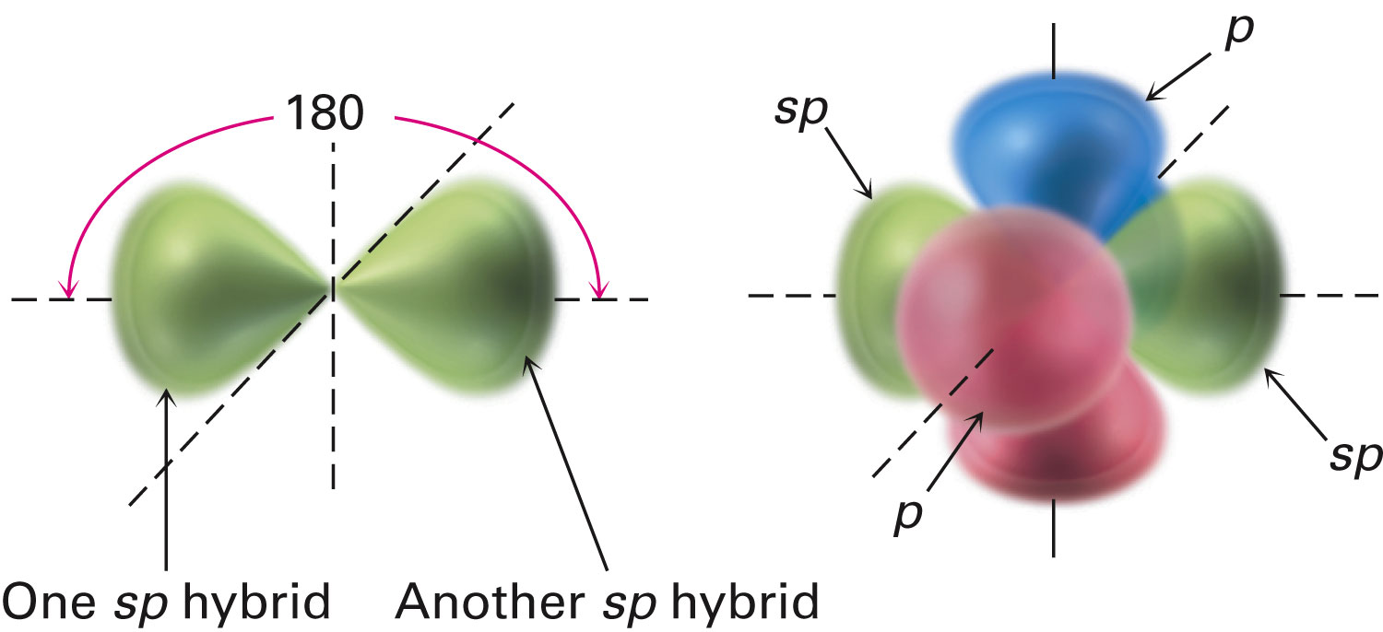
Figure 1.15 - sp Hybridization
Notes:
sp hybrid orbitals and the structure of acetylene

Slide 44
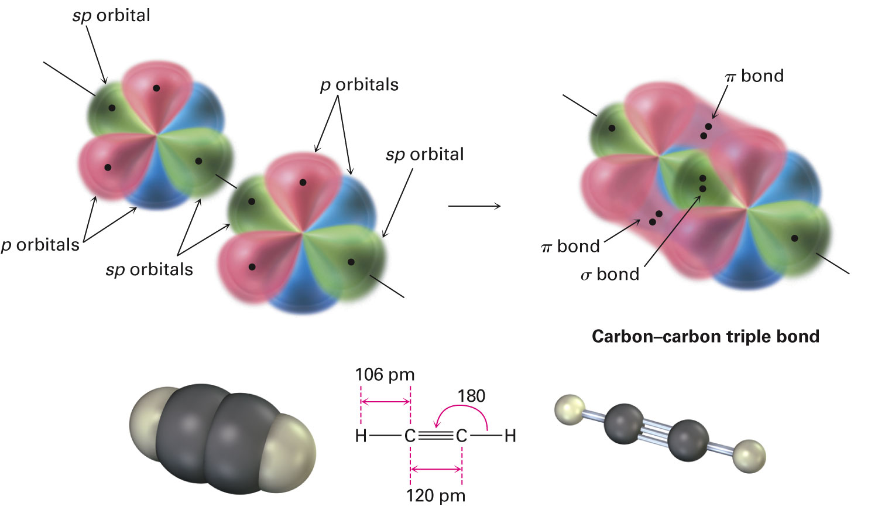
Orbitals of Acetylene
Two sp hybrid orbitals from each C form sp–sp σ bond
p_{z} orbitals from each C form a p_{z}–p_{z} π bond by sideways overlap
p_{y} orbitals overlap to form p_{y}–p_{y} π bond
Notes:
sp hybrid orbitals and the structure of acetylene

Slide 45
Bonding in Acetylene
Sharing of six electrons forms C≡C
Two sp orbitals form σ bonds with hydrogens
Shortest and strongest carbon–carbon bond
Notes:
sp hybrid orbitals and the structure of acetylene

Slide 46
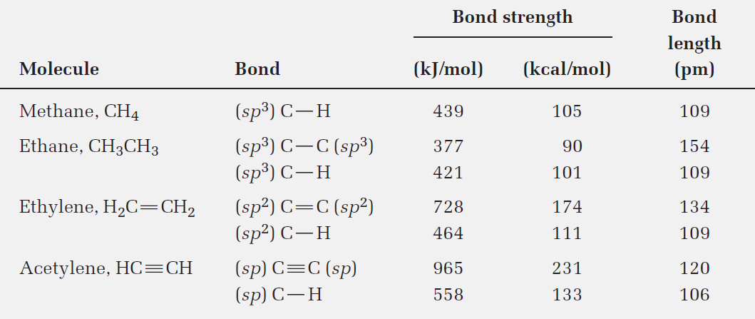
Table 1.2 - Comparison of C–C and C–H Bonds in Methane, Ethane, Ethylene, and Acetylene
Notes:
sp hybrid orbitals and the structure of acetylene

Slide 47
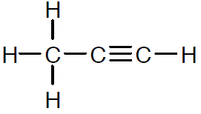
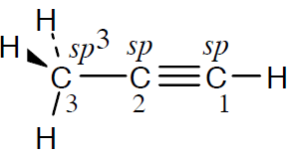
Worked Example
Draw a line-bond structure for propyne, CH₃C≡CH
Indicate the hybridization of the orbitals on each carbon
Predict a value for each bond angle
Solution:
Notes:
sp hybrid orbitals and the structure of acetylene

Slide 48
Worked Example
C3-H bonds are σ bonds
Overlap of an sp³ orbital of carbon
3 with s orbital of hydrogen
C1-H bond is a σ bond
Overlap of an sp orbital of carbon
1 with an s orbital of hydrogen
C2-C3 bond is a σ bond
Overlap of an sp orbital of carbon
2 with an sp³ orbital of carbon 3
Three C1-C2 bonds
Notes:
sp hybrid orbitals and the structure of acetylene

Slide 49
Worked Example
Bond angle
Between three carbon atoms is 180°
H–C1≡C2 is 180°
Between hydrogen and the sp³-hybridized carbon is 109°
Notes:
sp hybrid orbitals and the structure of acetylene

Slide 50
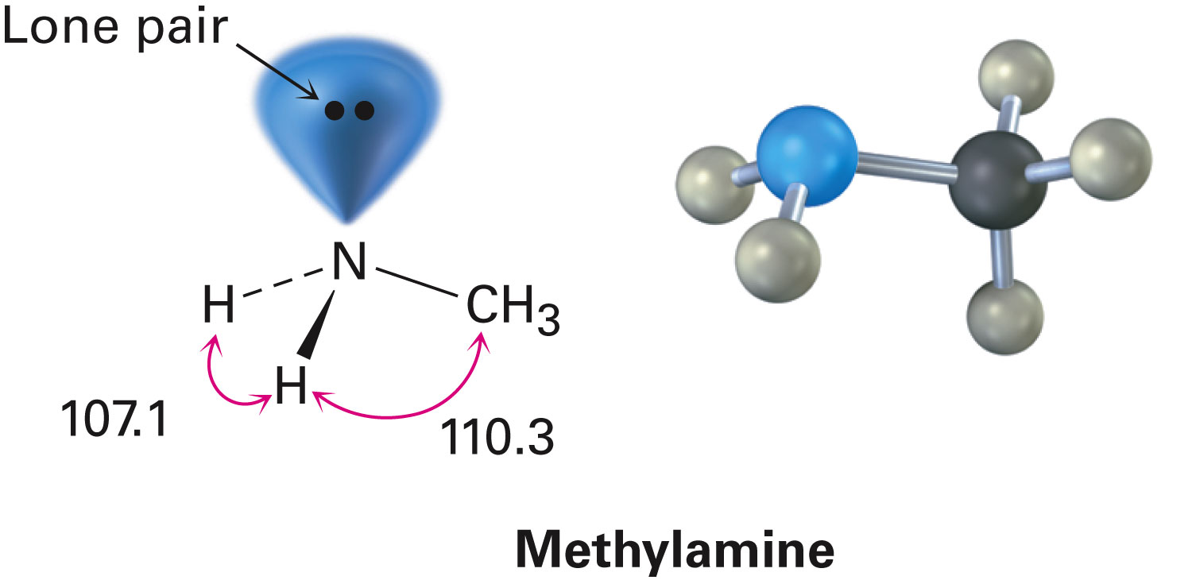
Hybridization of Nitrogen, Oxygen, Phosphorus, and Sulfur
H–N–H bond angle in methylamine 107.1°
C–N–H bond angle is 110.3°
N’s orbitals hybridize to form four sp³ orbitals
One sp³ orbital is occupied by two nonbonding electrons, and three sp³ orbitals have one electron each
Notes:
Hybridization of nitrogen, oxygen, phosphorus, and sulfur

Slide 51
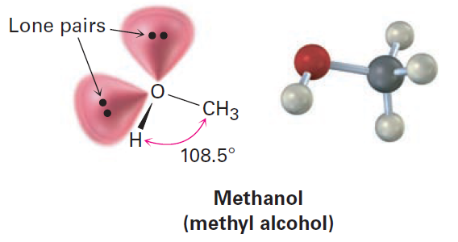
Hybridization of Nitrogen, Oxygen, Phosphorus, and Sulfur
Oxygen atom in methanol can be described as sp³-hybridized
C–O–H bond angle in methanol is 108.5
Two sp³ hybrid orbitals on oxygen are occupied by nonbonding electron lone pairs
Notes:
Hybridization of nitrogen, oxygen, phosphorus, and sulfur

Slide 52
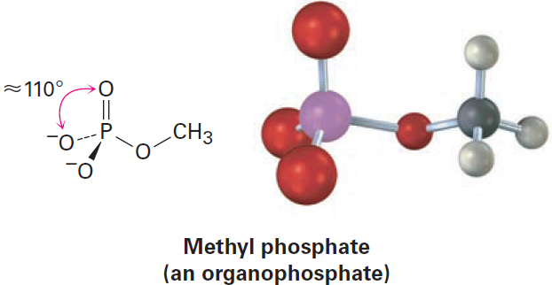
Hybridization of Nitrogen, Oxygen, Phosphorus, and Sulfur
Methyl phosphate, CH₃OPO₃²⁻
O–P–O bond angle is approximately 110 °to 112°
Implies sp³ hybridization in the phosphorus orbitals
Notes:
Hybridization of nitrogen, oxygen, phosphorus, and sulfur

Slide 53
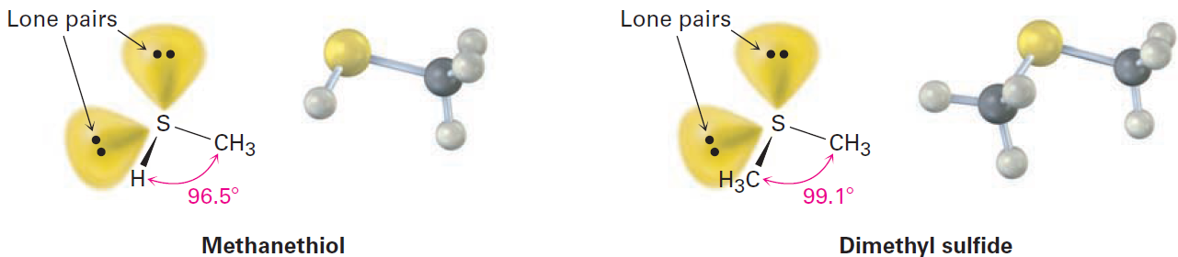
Hybridization of Nitrogen, Oxygen, Phosphorus, and Sulfur
Dimethyl sulfide [(CH₃)₂S] is the simplest example of a sulfide
Described by approximate sp³ hybridization around sulfur
Have significant deviation from the tetrahedral angle
Notes:
Hybridization of nitrogen, oxygen, phosphorus, and sulfur

Slide 54
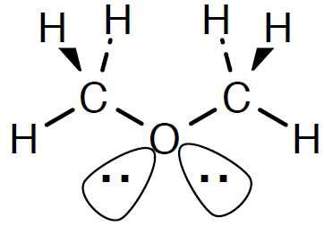
Worked Example
Identify all nonbonding lone pairs of electrons in the oxygen atom in dimethyl ether, CH₃–O–CH₃
What is its expected geometry
Solution:
The sp³-hybridized oxygen atom has tetrahedral geometry
Notes:
Hybridization of nitrogen, oxygen, phosphorus, and sulfur

Slide 55
Molecular Orbital (MO) Theory
Description of covalent bond formation as resulting from a mathematical combination of atomic orbitals to form molecular orbitals
Bonding MO: Molecular orbital that is lower in energy than the atomic orbitals from which it is formed
Antibonding MO: Molecular orbital that is higher in energy than the atomic orbitals from which it is formed
Notes:
Describing chemical bonds: Molecular orbital theory

Slide 56
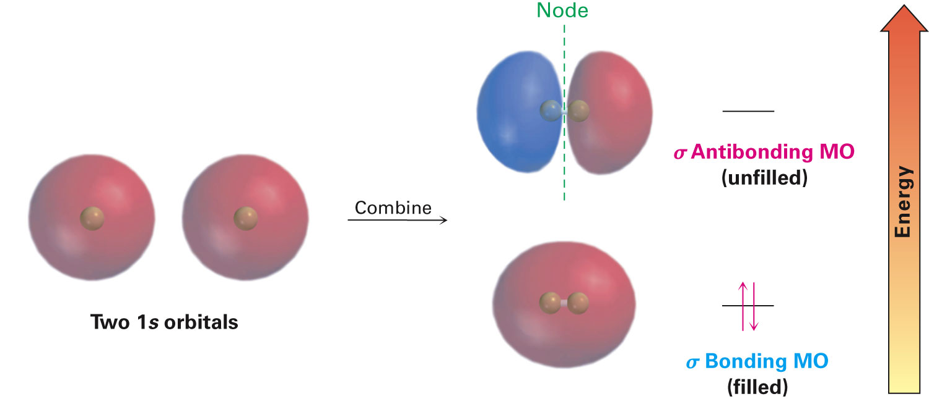
Figure 1.17 - Molecular Orbitals of H₂
Notes:
Describing chemical bonds: Molecular orbital theory

Slide 57
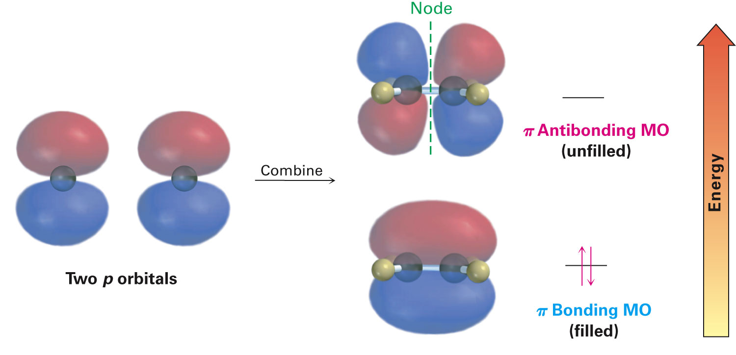
Molecular Orbital Theory
The π bonding MO is from combining p orbital lobes with the same algebraic sign
The π antibonding MO is from combining lobes with opposite signs
Only bonding MO is occupied
Notes:
Describing chemical bonds: Molecular orbital theory

Slide 58
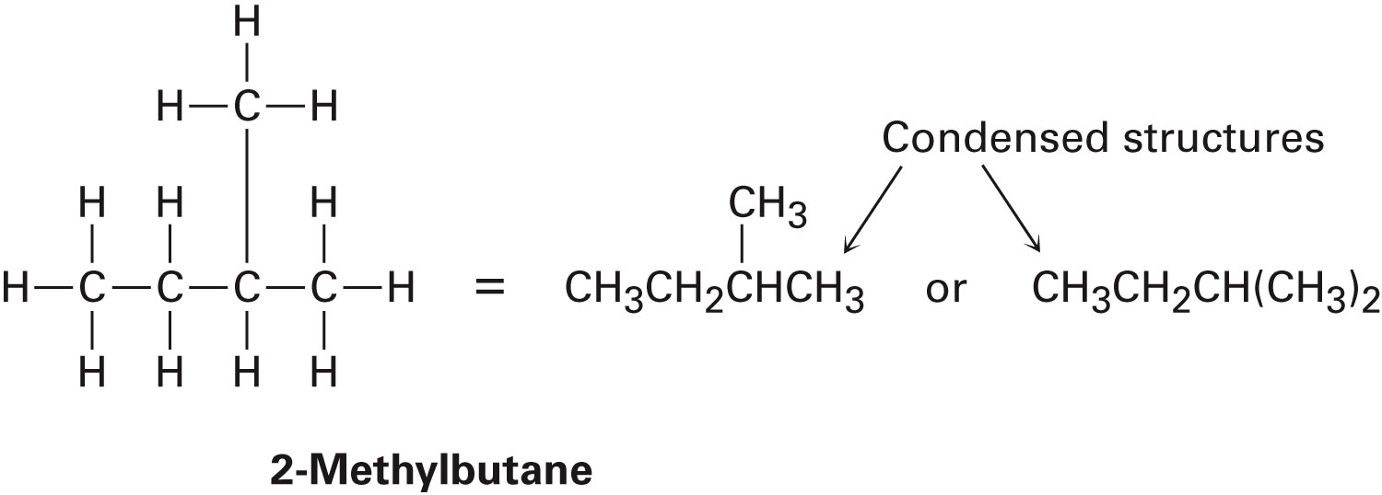
Drawing Chemical Structures
Several shorthand methods have been developed to write structures
Condensed structures: C-H or C-C single bonds are not shown, they are understood
Example
Notes:
Drawing chemical structures

Slide 59
Rules for Drawing Skeletal Structures
Carbon atoms aren’t usually shown
Carbon atom is assumed to be at each intersection of two lines (bonds) and at the end of each line
Hydrogen atoms bonded to carbon aren’t shown
Atoms other than carbon and hydrogen are shown
Notes:
Drawing chemical structures

Slide 60
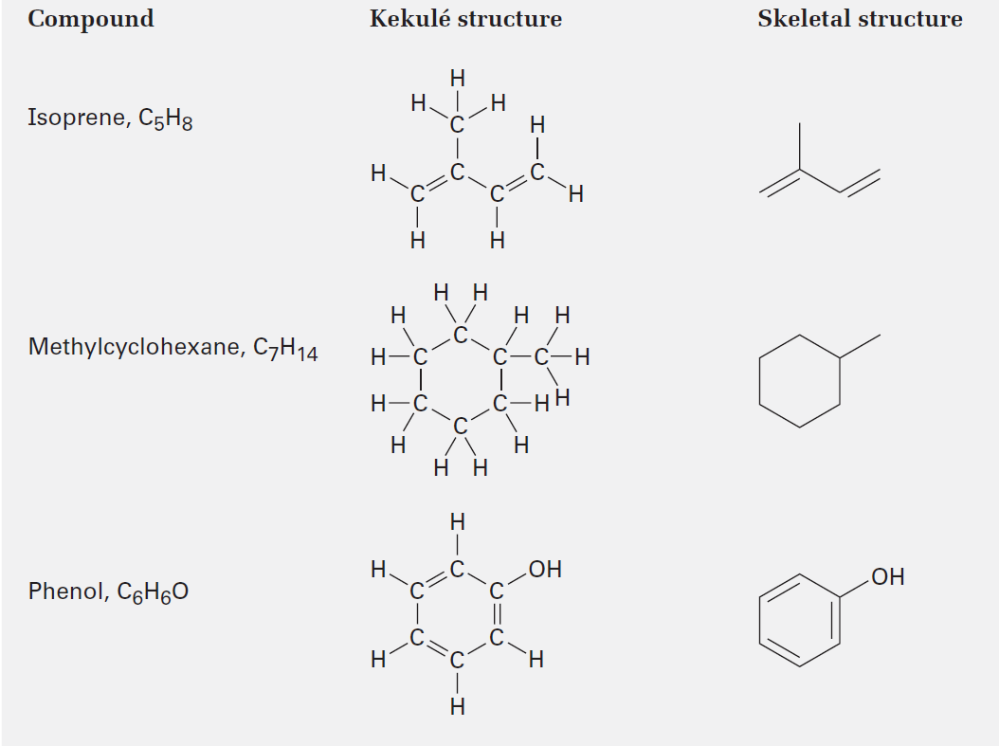
Table 1.3 - Kekulé and Skeletal Structures for Some Compounds
Notes:
Drawing chemical structures

Slide 61
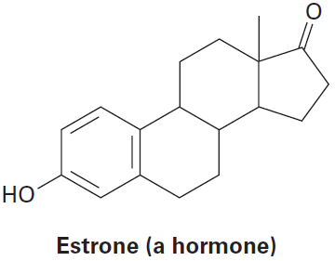
Worked Example
How many hydrogens are bonded to each carbon in the following compound
Give the molecular formula of each substance
Notes:
Drawing chemical structures

Slide 62
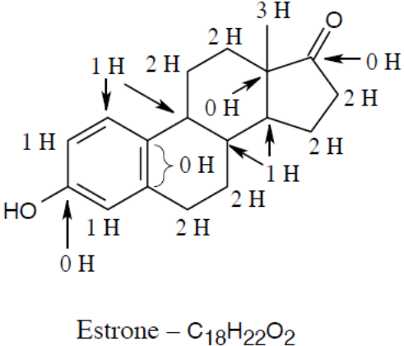
Worked Example
Solution:
Notes:
Drawing chemical structures

Slide 63
Summary
Organic chemistry - Study of carbon compounds
Atom: Charged nucleus containing positively charged protons and neutrally charged neutrons surrounded by negatively charged electrons
Electronic structure of an atom is described by wave equation
Different orbitals have different energy levels and different shapes
s orbitals are spherical, p orbitals are dumbbell-shaped

Slide 64
Summary
Covalent bonds - Electron pair is shared between atoms
Valence bond theory - Electron sharing occurs by the overlapping of two atomic orbitals
Molecular orbital (MO) theory - Bonds result from combination of atomic orbitals to give molecular orbitals, which belong to the entire molecule

Slide 65
Summary
Sigma (σ) bonds - Circular cross-section and are formed by head-on interaction
Pi (π) bonds - Formed by sideways interaction of p orbitals
Carbon uses hybrid orbitals to form bonds in organic molecules
In single bonds with tetrahedral geometry, carbon has four sp³ hybrid orbitals
In double bonds with planar geometry, carbon uses three equivalent sp² hybrid orbitals and one unhybridized p orbital

Slide 66
Summary
Carbon uses two equivalent sp hybrid orbitals to form a triple bond with linear geometry, with two unhybridized p orbitals
Atoms such as nitrogen and oxygen hybridize to form strong, oriented bonds
Nitrogen atom in ammonia and the oxygen atom in water are sp³-hybridized
Structures in which carbon–carbon and carbon–hydrogen bonds aren’t shown are called condensed structures

